Slide 1

INT220 SERVER SIDE SCRIPTING
Lecture #0
The kick start session

Slide 2


Slide 3
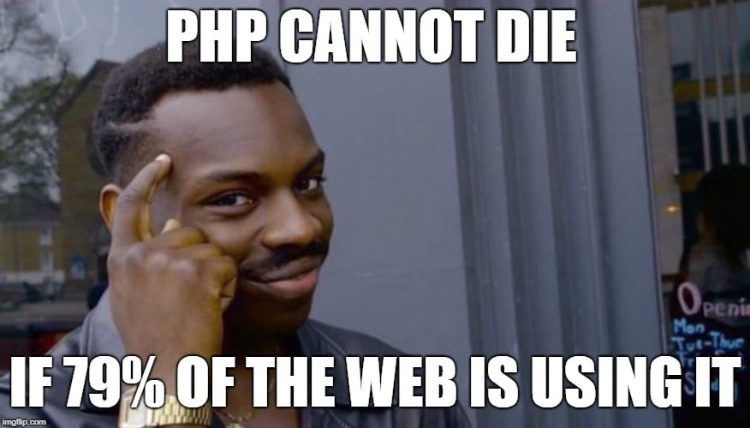

Slide 4


Slide 5
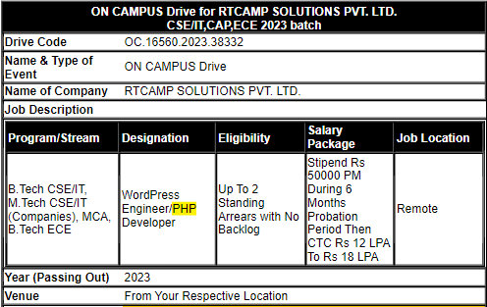

Slide 6

Course details
LTP – 2 0 2
Credit – 3

Slide 7
Assessment/Evaluation Scheme
Attendance: 5
CA: 45
ETT: 50

Slide 8
Complete evaluation criteria for the course
CA1: 30 marks- Test
CA2: 30 marks- Test
CA3: 30 marks- Project

Slide 9
Course outcome
Through this course students should be able to:
CO1 :: Understand process of executing a PHP script on a web server.
CO2 :: Use sessions and cookies to store users information.
CO3 :: Use the methods for dealing with form-based data and how they are accessed inside a PHP script.
CO4 :: Validate input from user before sending it to the database using PHP.
CO5 :: Develop a dynamic and responsive website with database connectivity using MySQL and PHP.
CO6 :: Construct PHP programs that use various PHP library functions that manipulate files and directories.

Slide 10
Course contents
Unit I
PHP Fundamentals : PHP, MySQL and XAMPP Installation, PHP Basic Syntax, PHP Data Types, PHP Variables, PHP Constants, PHP Expressions, PHP Operators, PHP Control Structures, PHP Loops

Slide 11
Course contents
Unit II
PHP Arrays and Functions : PHP Enumerated Arrays, PHP Associative Arrays, PHP Multi-Dimensional Arrays, PHP Functions, Syntax, Arguments and Variables, References, Pass by Value & Pass by references, Return Values, Variable Scope, PHP include() and PHP require()

Slide 12
Course contents
Unit III
PHP Forms : PHP Form handling, PHP GET and POST, PHP Form Validation, PHP Form Sanitization

Slide 13
Course contents
Unit IV
PHP Cookies, Sessions and Strings Handling : PHP Cookie Handling, PHP Session Handling, PHP Login Session, Strings and Patterns, Matching, PHP Sending Emails, PHP File Uploading, PHP Filters, PHP Error Handling

Slide 14
Course contents
Unit V
Object Oriented Programming in PHP : Defining PHP Classes, Creating Objects in PHP, Calling Member Functions, Constructor Functions, Inheritance, Function Overriding, Interface, Abstract Classes

Slide 15
Course contents
Unit VI
Basic MySQL and SQL Queries : Database Basics, Indexes, PHP MyAdmin, Connect & Pconnect, MySQL Create, MySQL Insert, MySQL Select, MySQL Update, MySQL Delete, MySQL Truncate, MySQL Drop, WHERE condition, Order By and Group By, Having, LIKE, AND OR operators, SQL functions AVG, COUNT, SUM, MIN, MAX, LCASE, UCASE

Slide 16
Text & Reference Books
Text Books: PROGRAMMING PHP by KEVIN TATROE, O'REILLY, 3rd Edition.
References: PHP: THE COMPLETE REFERENCE by STEVEN HOLZNER, MCGRAW HILL EDUCATION, 1st Edition.
PHP AND MySQL WEB DEVELOPMENT: A BEGGINER’S GUIDE by MARTY MATTHEWS, MCGRAW HILL EDUCATION, 1st Edition.

